Slide 1
Team 3: Megalodon

Slide 2
Project: Game Shop
Members:
1. Nguyễn Phát Đạt
2. Dương Ngọc Nguyên Phương
3. Nguyễn Văn An
4. Hà Vũ Đạt
5. Nguyễn Hữu Sơn

Slide 3
OVERVIEWS
Classification | Content
Service | Display various games with recommended options, payment method, discount, feedback.
Background | We’re trying to combine user-friendly and aesthetically-pleasing features, ensure your account privacy.
Purpose | Help customer easy to search game product, providing qualified games for customer with many different competitive level of price.
Expectation | Increasing approaching ability with many type of clients, help save the time and effort for shop’s owner, increasing profit and earning for shop.
Main functions | + Login/Register/Logout. + Manage Game Products + Cart (Buy, Edit), Payment + Search + Statistics, Manage users, Category, comments, Blog (News)
Targeted clients | Concerned objects
Service channel | Web, Internet
Publishing time | 23/07

Slide 4
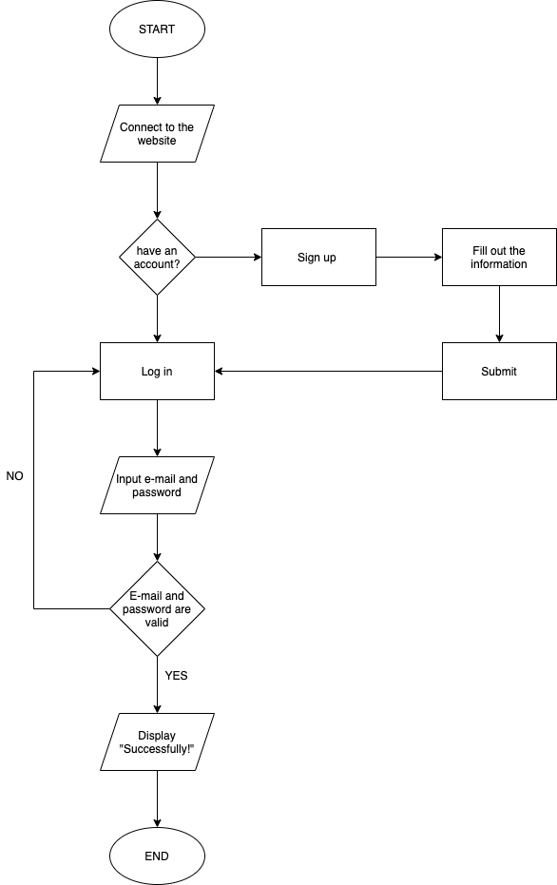
FLOWCHART
LOGIN

Slide 5
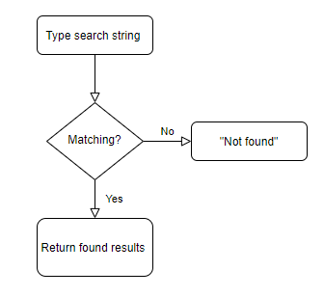
FLOWCHART
SEARCHING

Slide 6
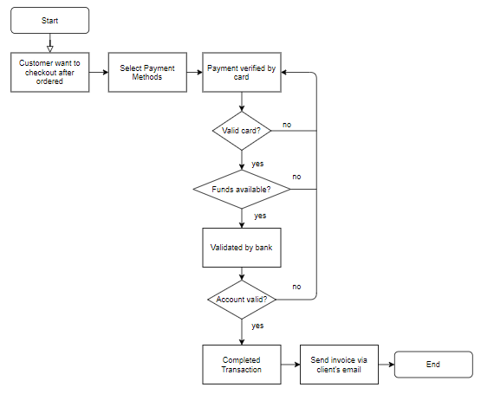
FLOWCHART
PAYMENT

Slide 7
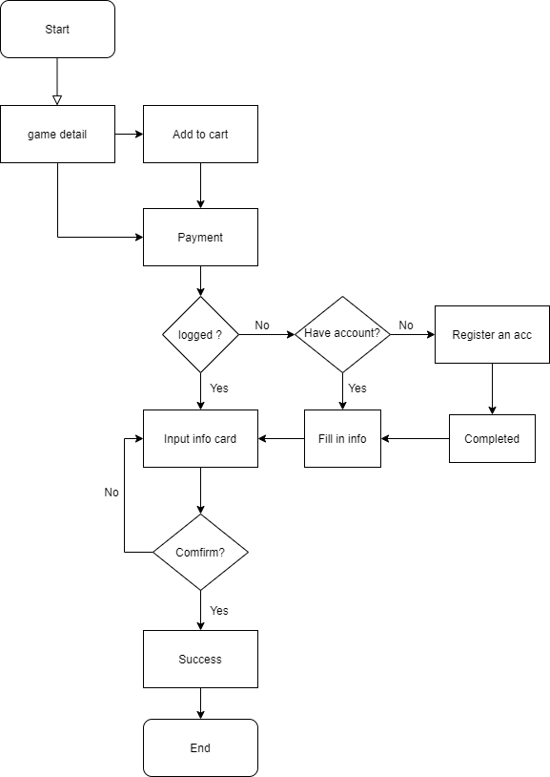
FLOWCHART
BUY GAME

Slide 8
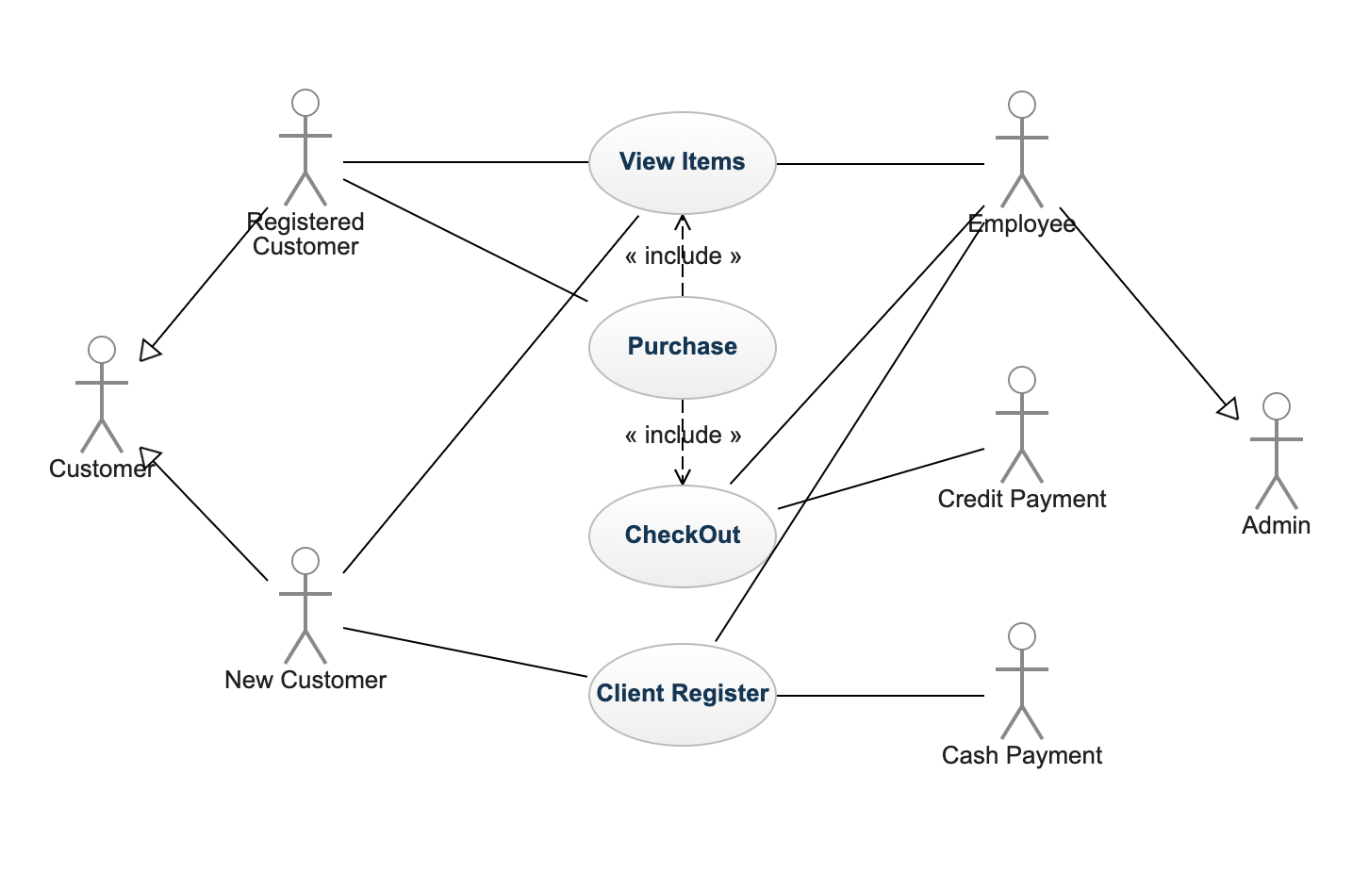
USE-CASE DIAGRAM
WEB CUSTOMER

Slide 9
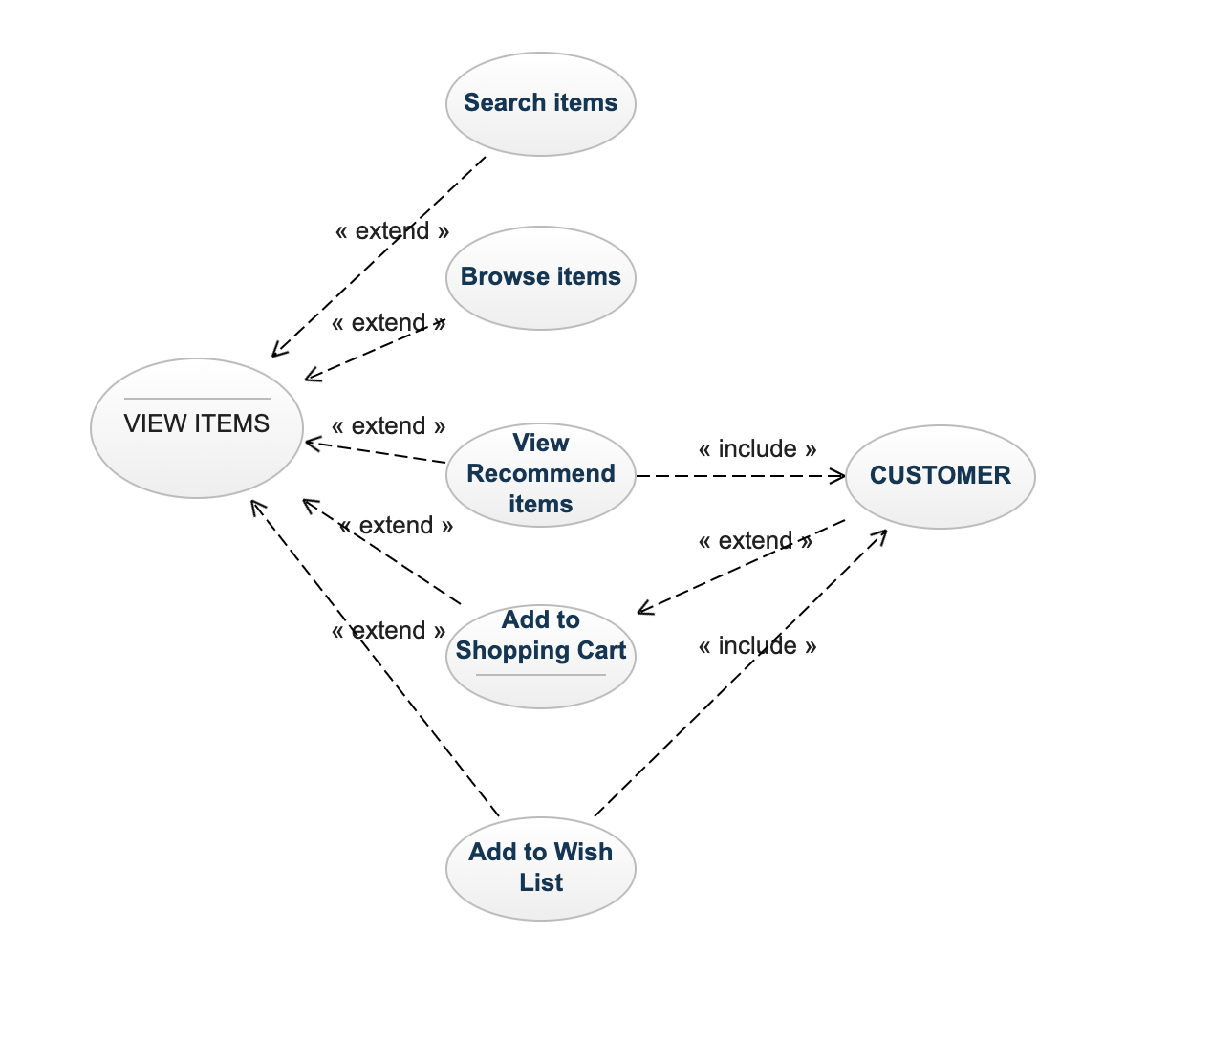
USE-CASE DIAGRAM
VIEW ITEMS

Slide 10
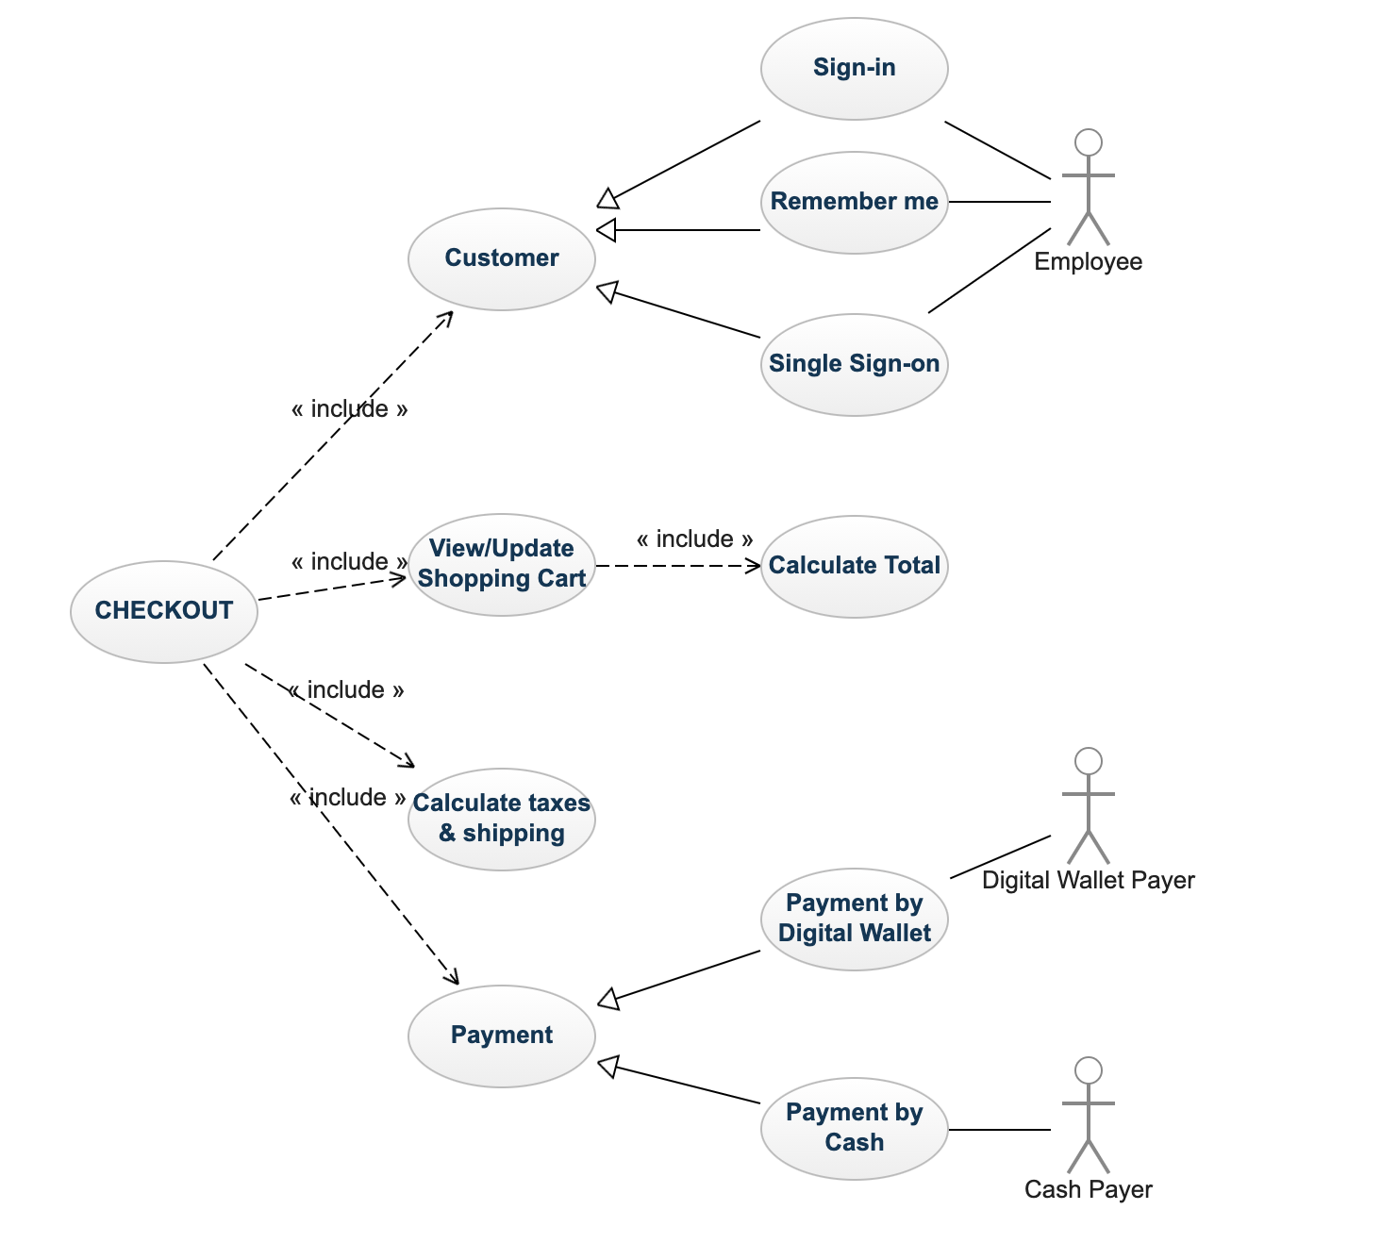
USE-CASE DIAGRAM
CHECKOUT

Slide 11
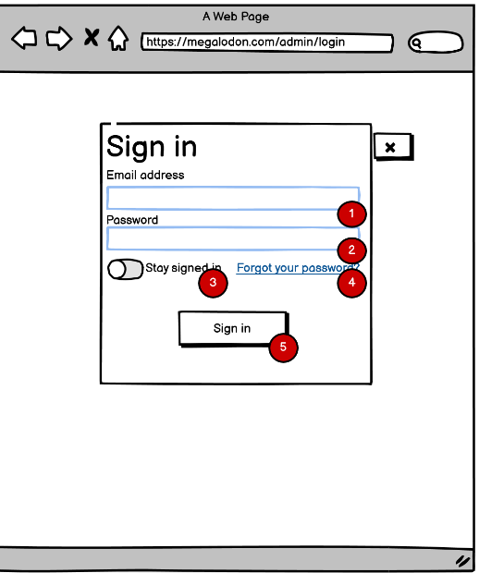
Story board
Description:
Input email account to login: Typing gmail Admin account, employee gmail account.
Input password to login: Typing Admin password or employee password.
Button to save account and password: Used to save accounts and passwords on the local computer.
The link for forgot password case: Go to a web page and restore the former password.
Sign in Button: Used to login with suitable account and password go to indexAdmin page.

Slide 12
Admin Page

Slide 13
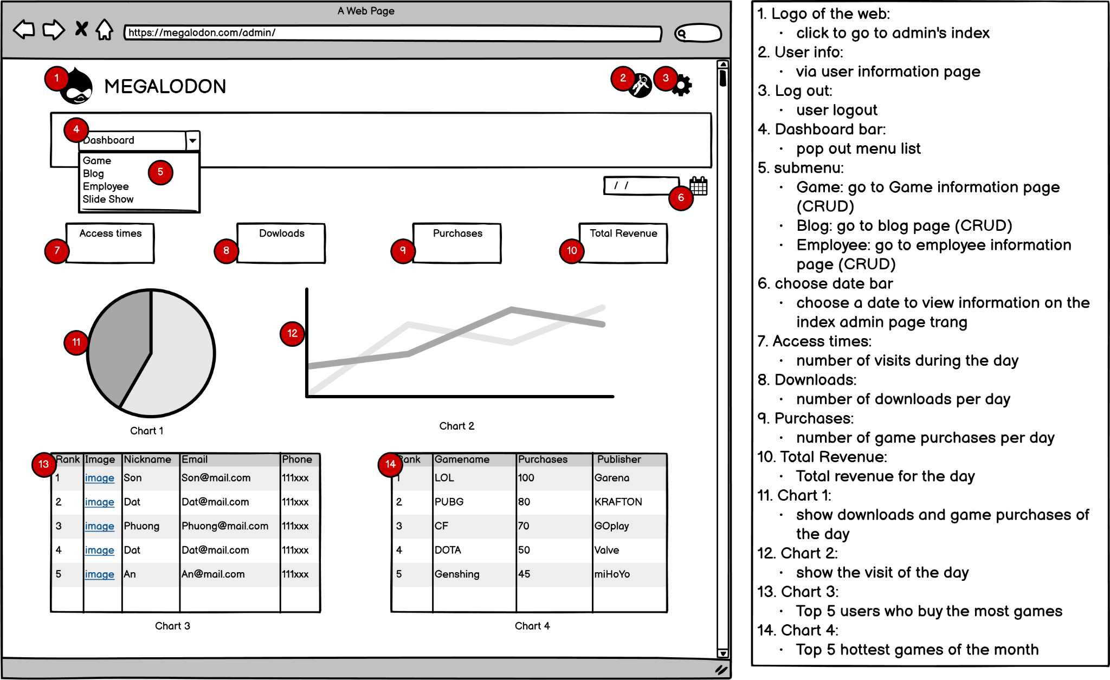

Slide 14
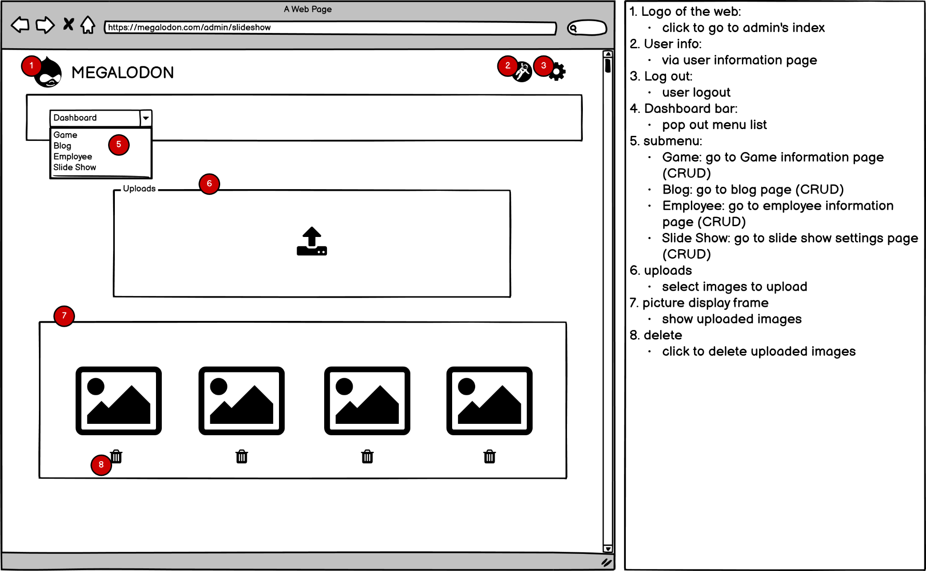

Slide 15
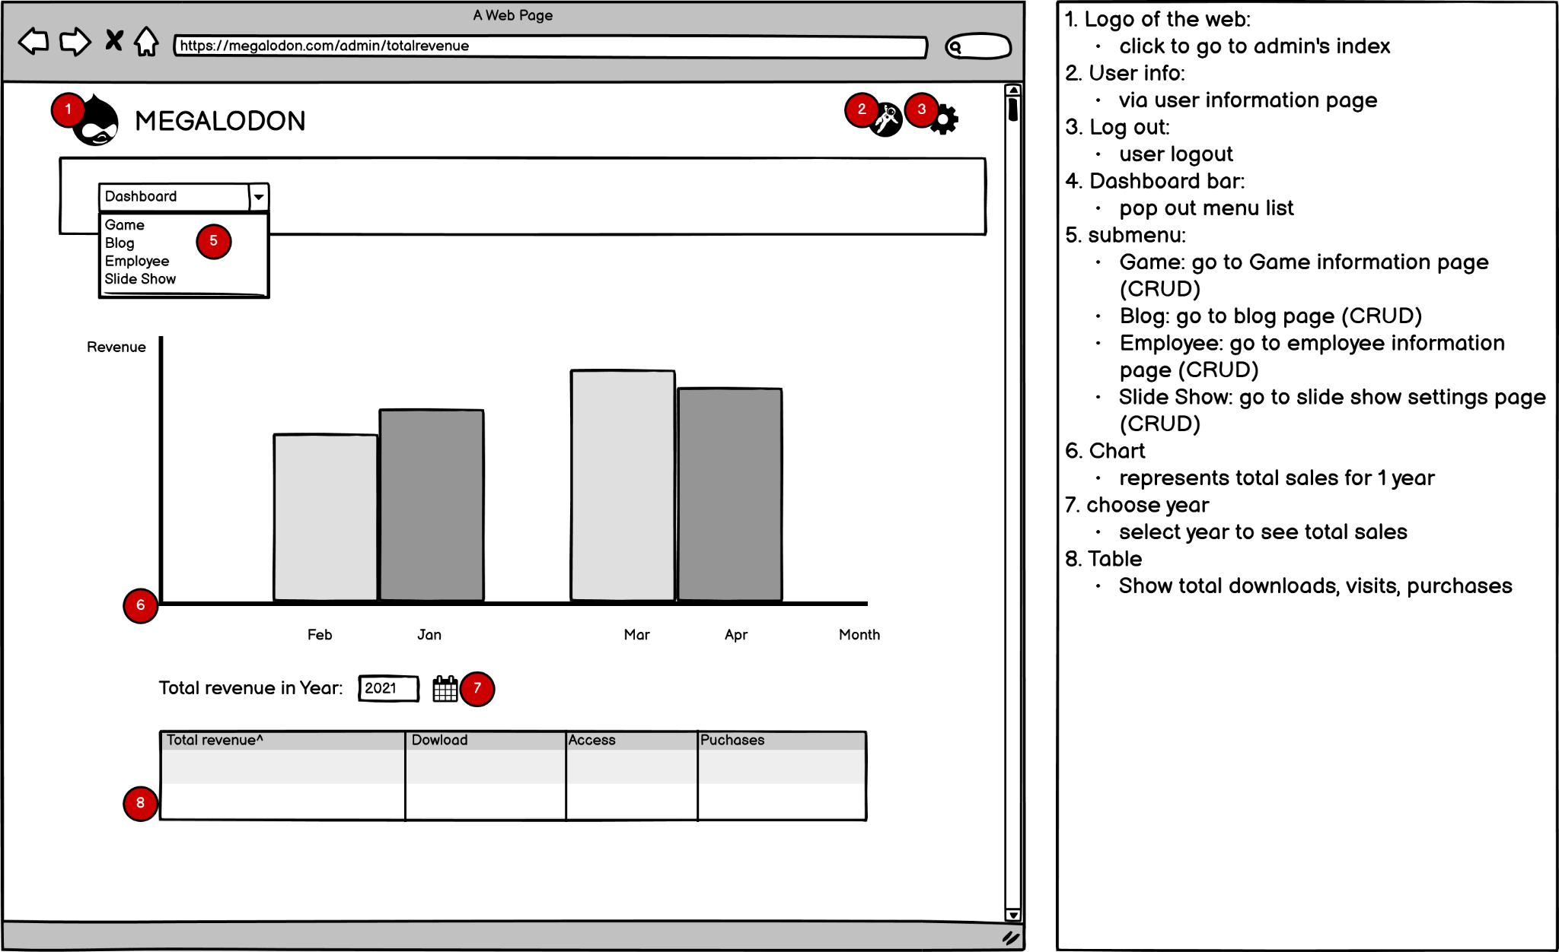

Slide 16
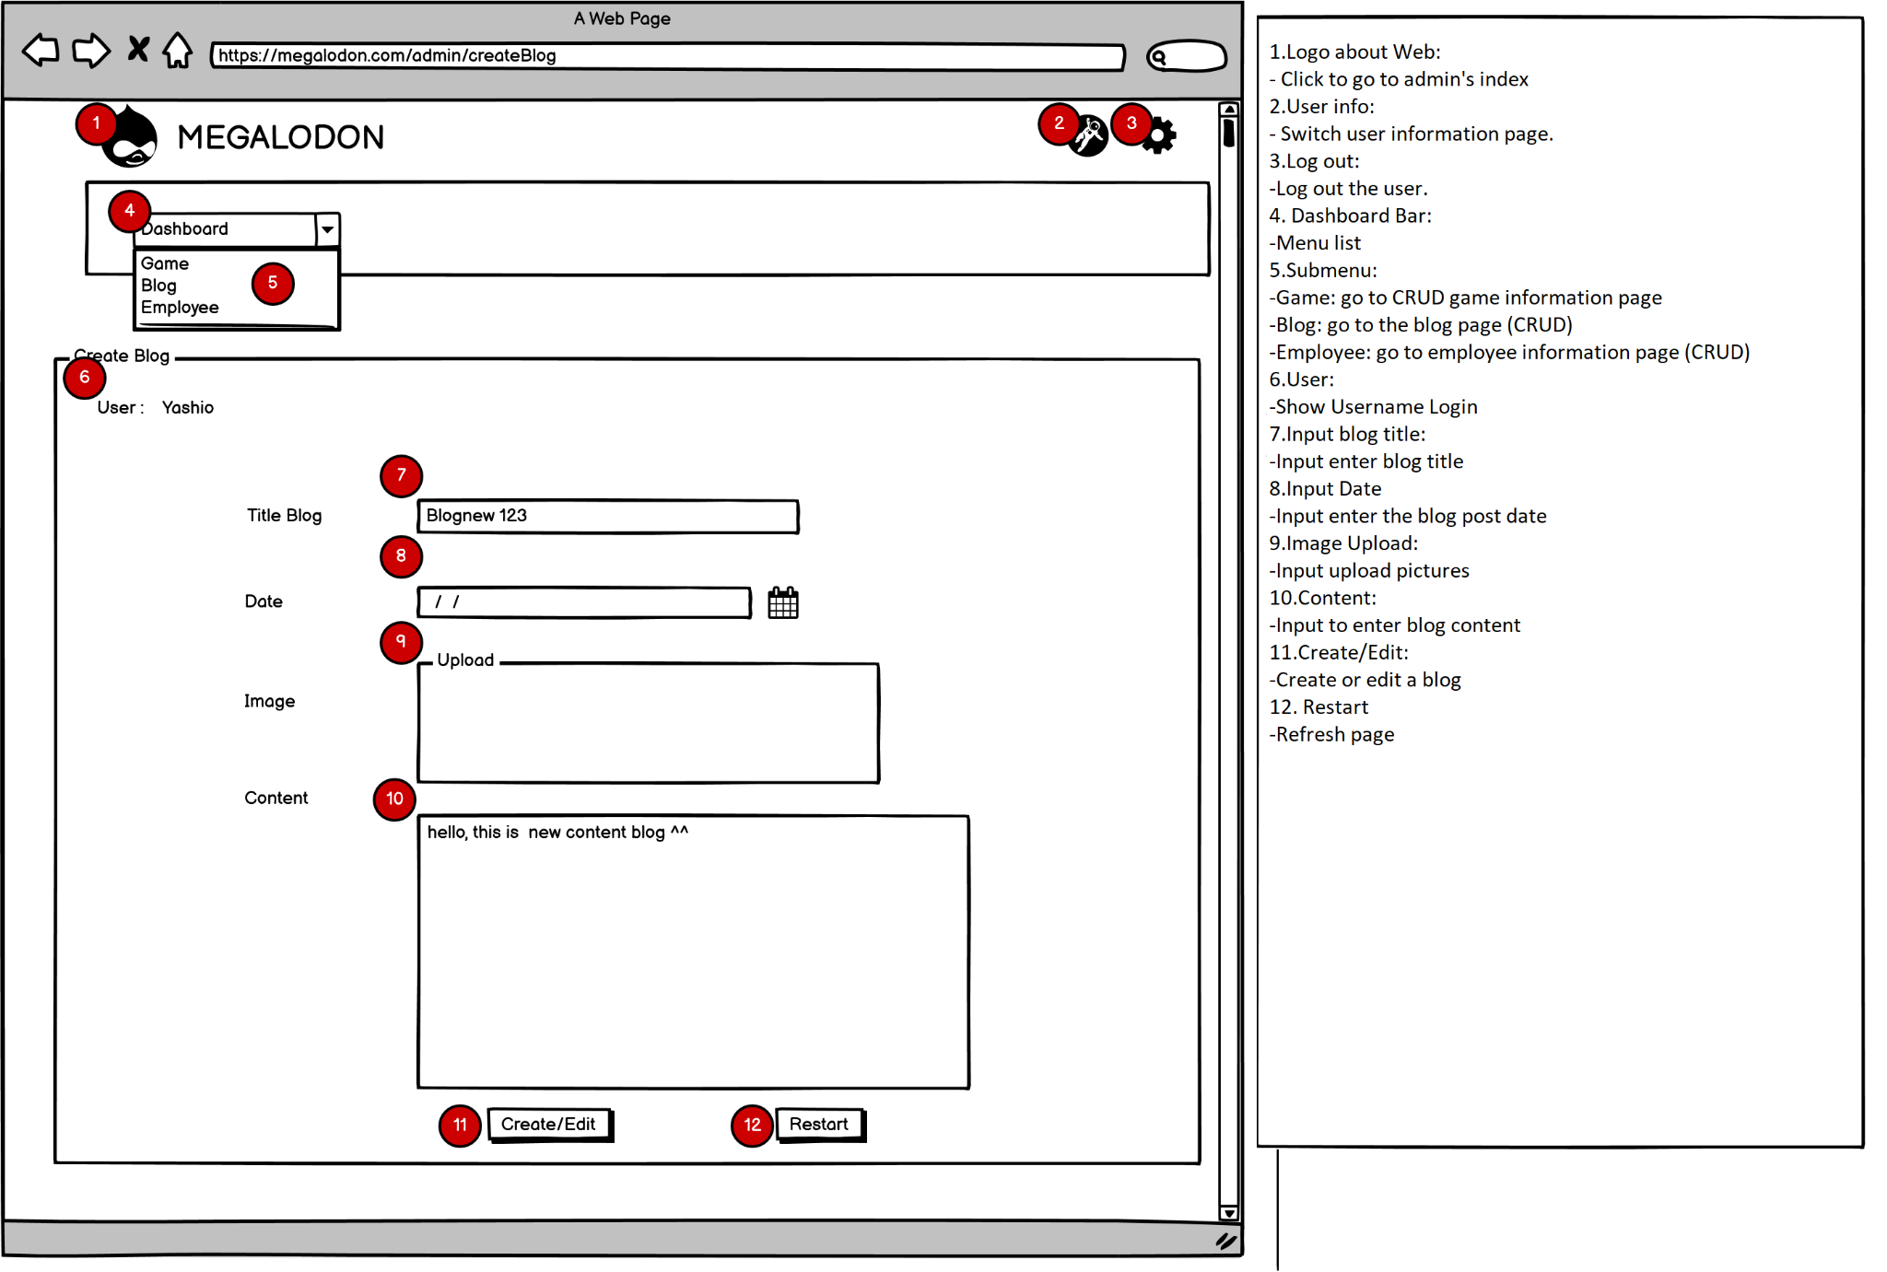

Slide 17
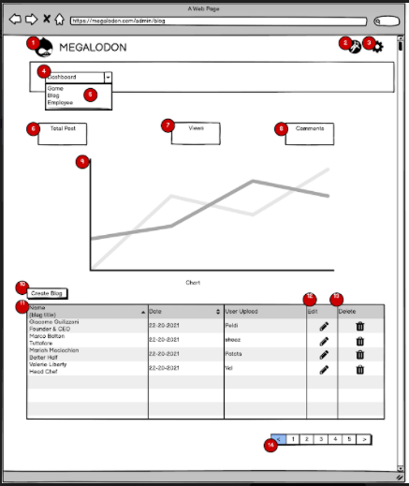
Story board
Description:
Web logo: Click it to go to Admin Index page.
User Info: forwarding to user information page
Logout: log out current user.
DashBoard bar: drop menu items list down.
SubMenu:
Game: forwarding to Game management.
Blog: forwarding to Blog management.
Employee: forwarding to Employee management.
Total post: show total number of Posts.
Views: show total number of views.
Comments: show total number of comments.
Chart displays views by month.
Create Blog: go to New Blog page.
Table List Blog: display Blog List
Edit: go to edit corresponding Blog.
Delete: remove selected Blog.
Paging for showing Blog list by table.

Slide 18
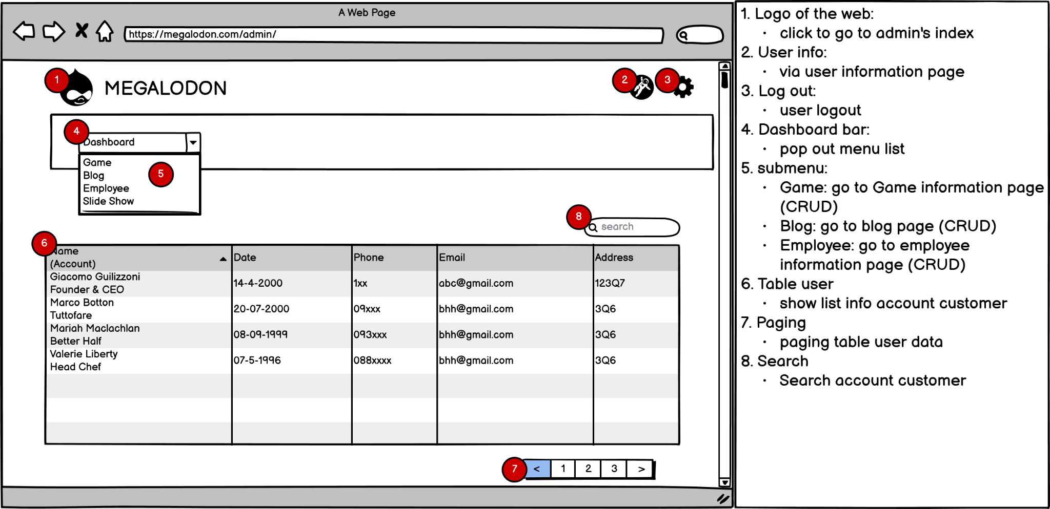

Slide 19
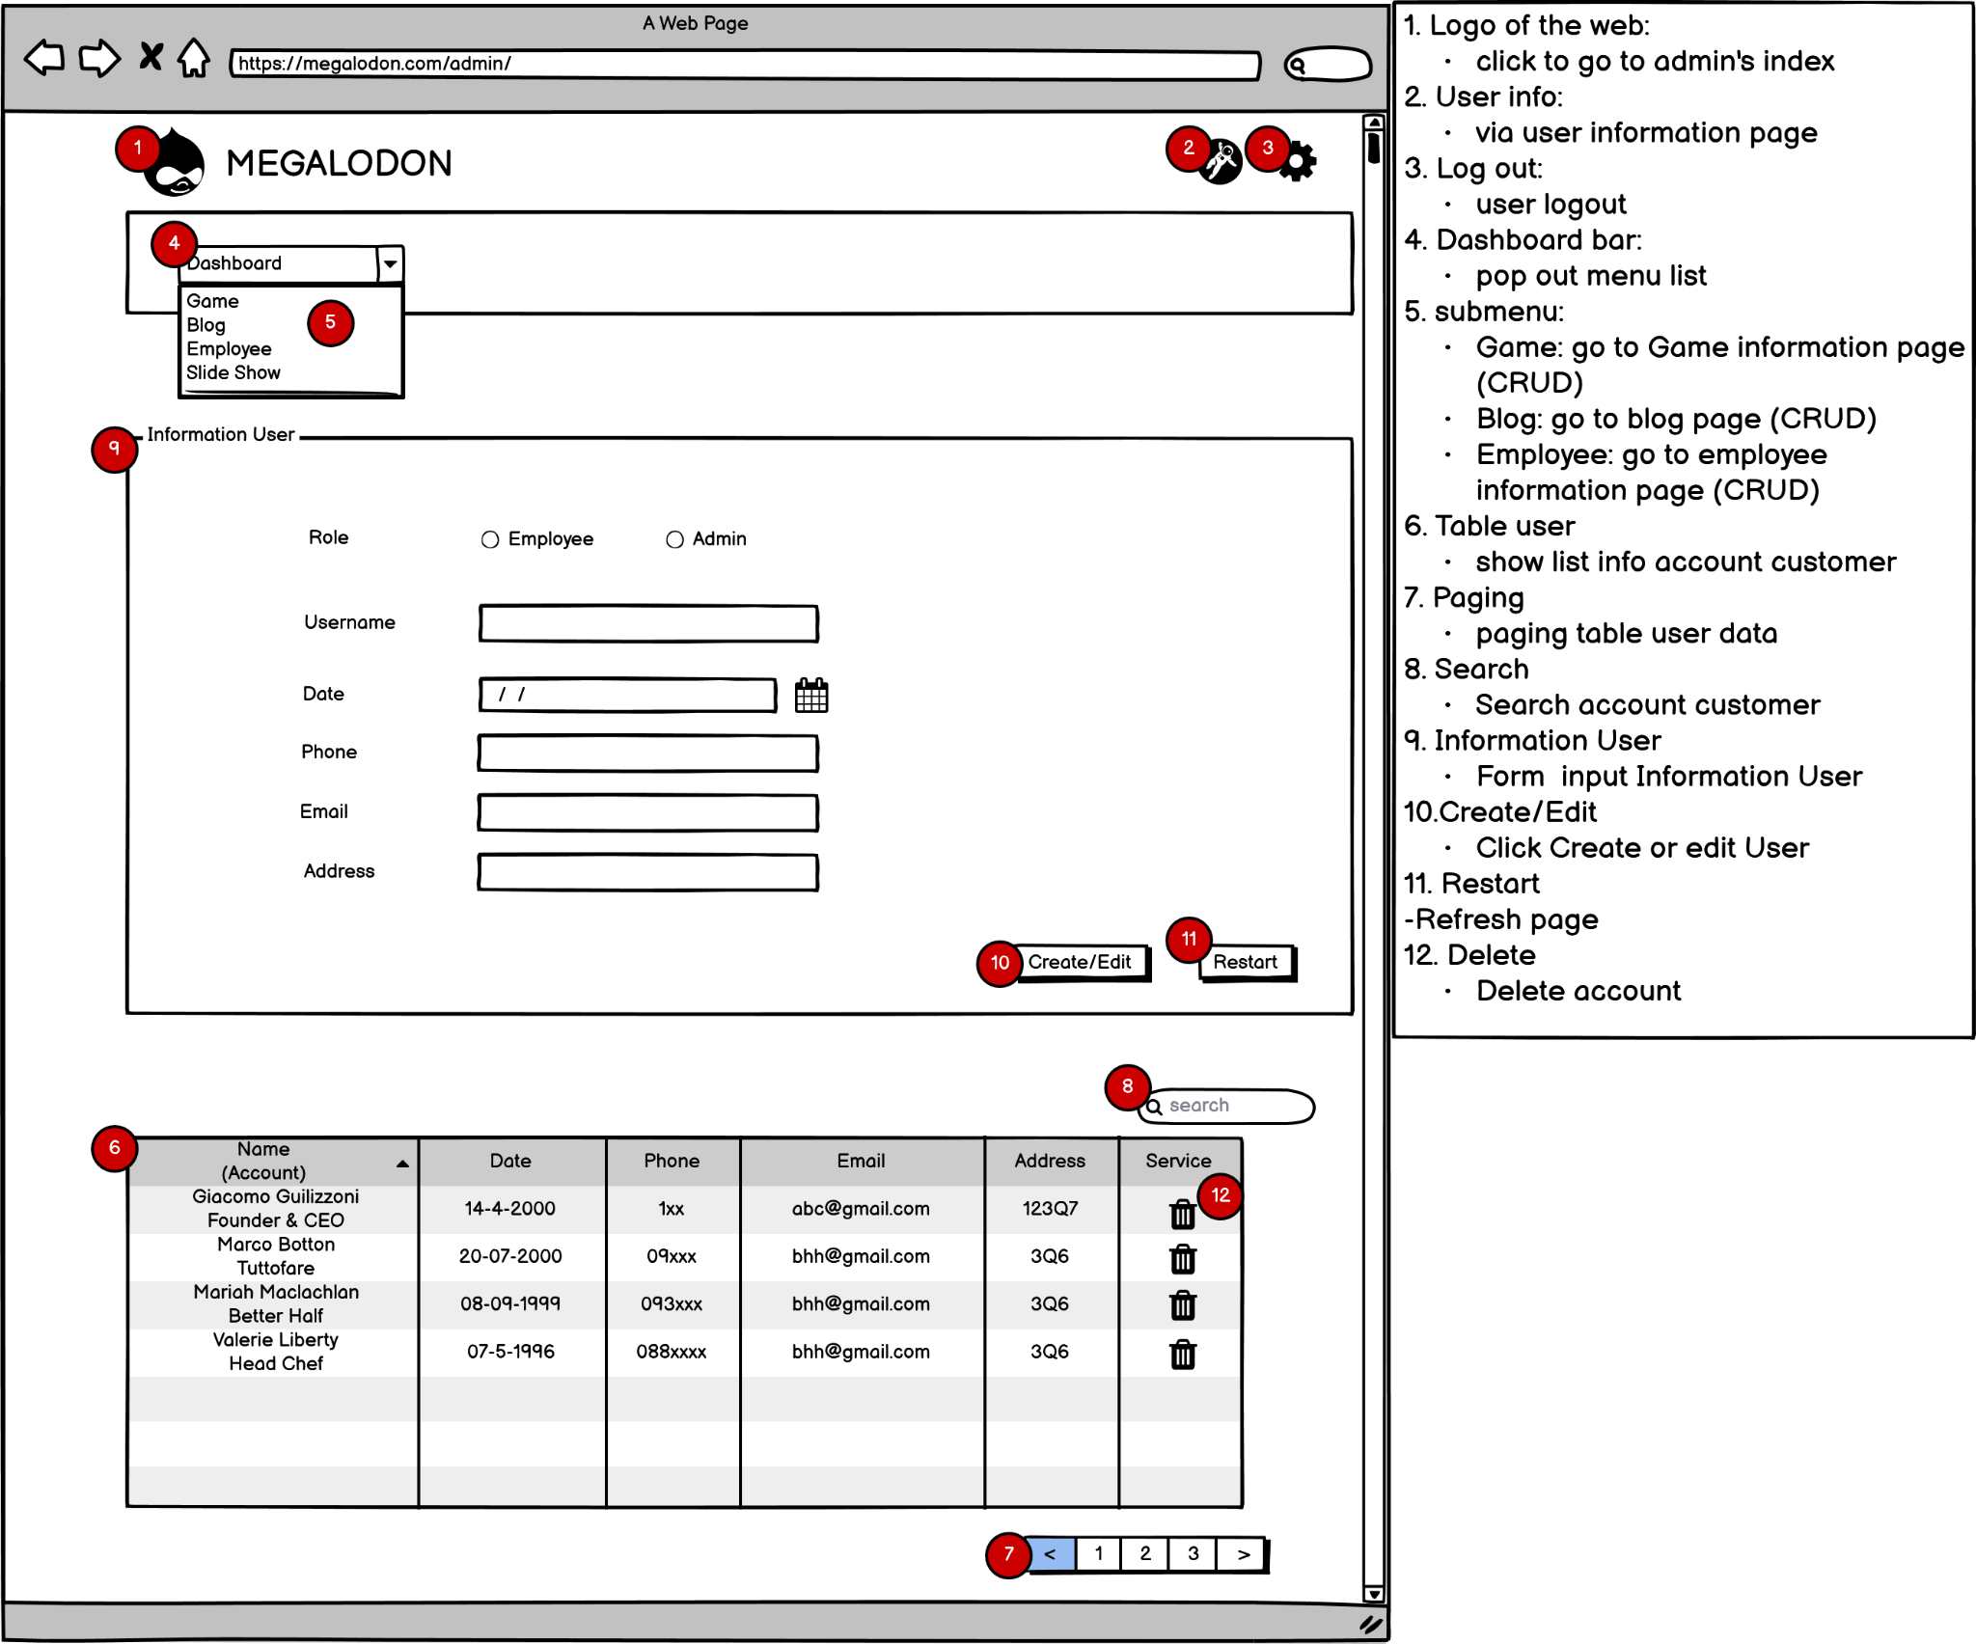

Slide 20
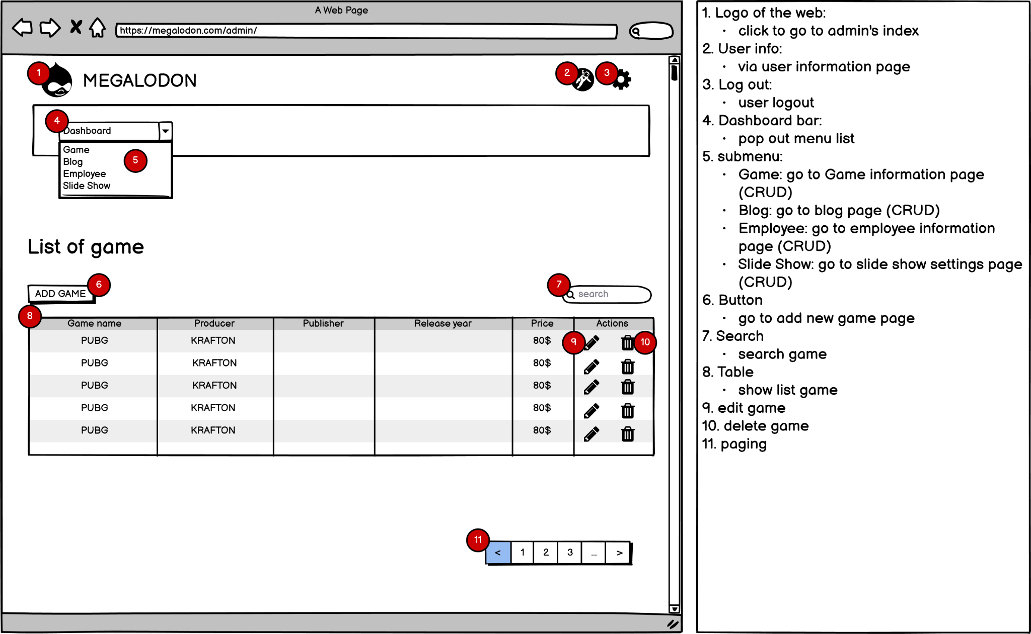

Slide 21
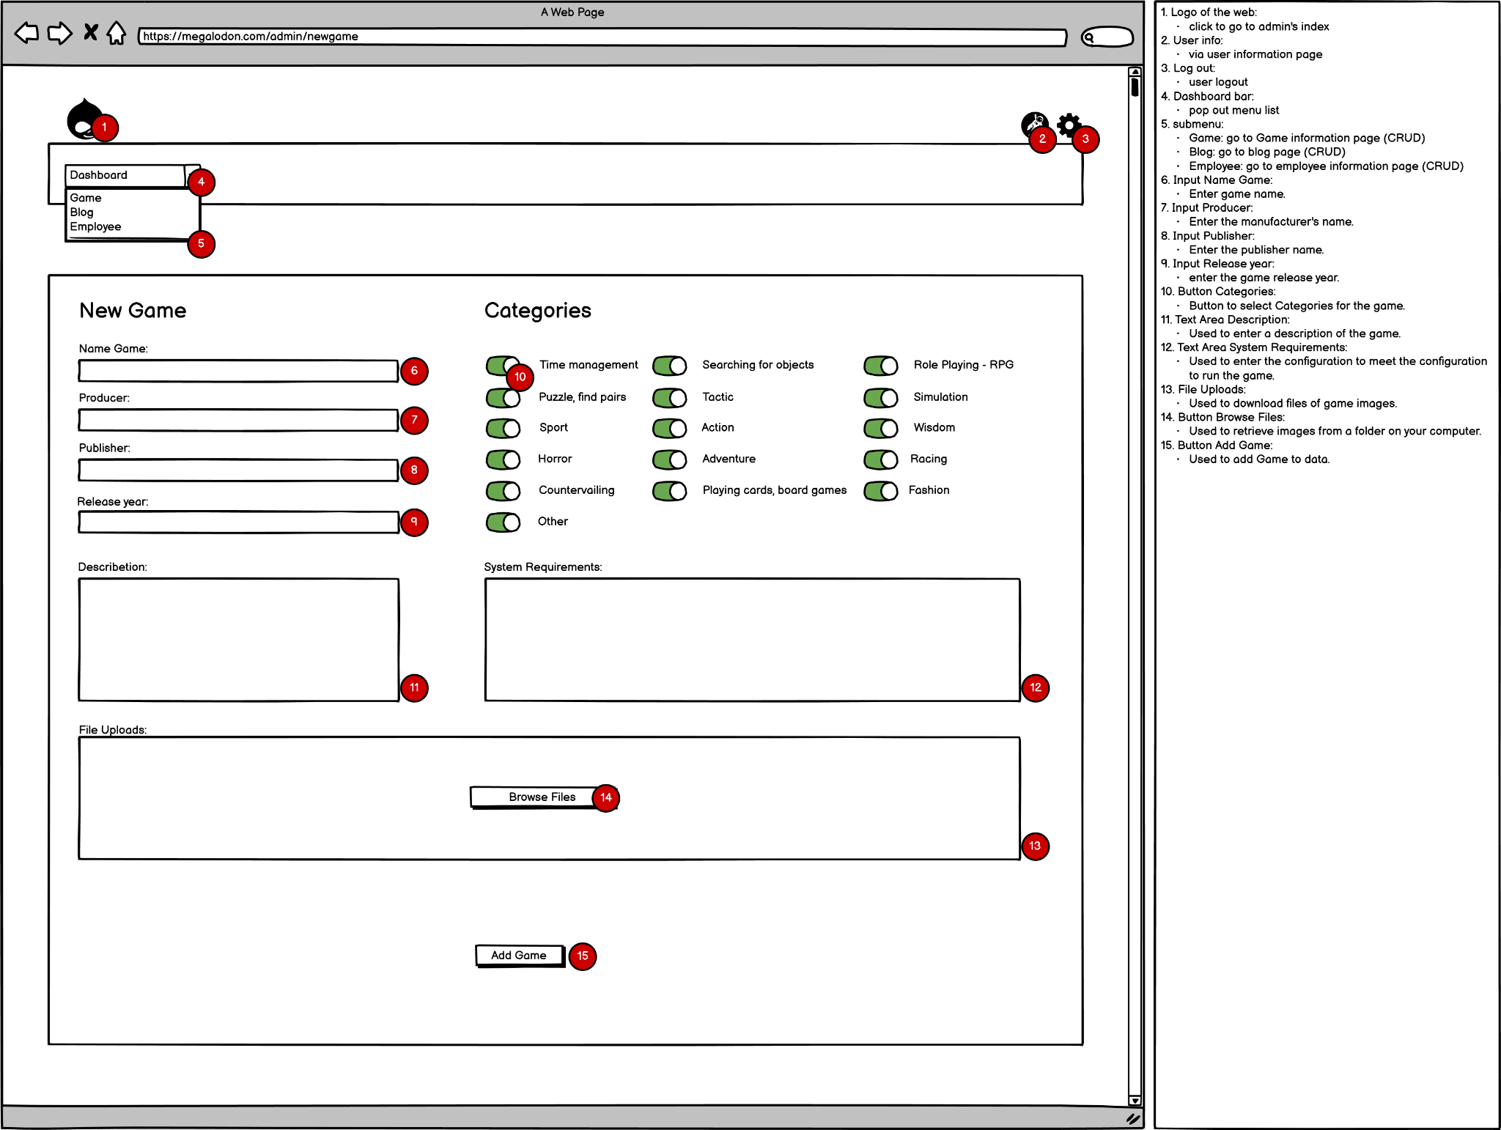

Slide 22
game shop

Slide 23
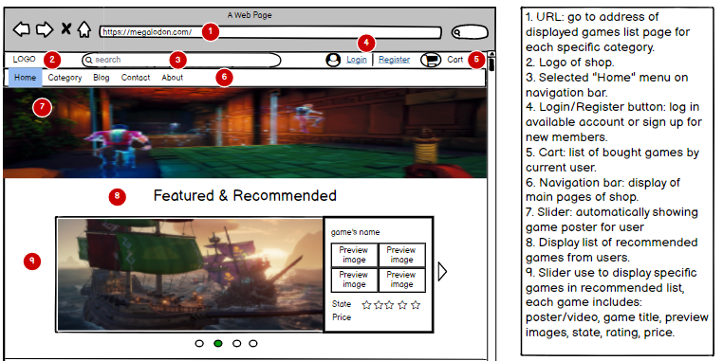
Home Page 1

Slide 24
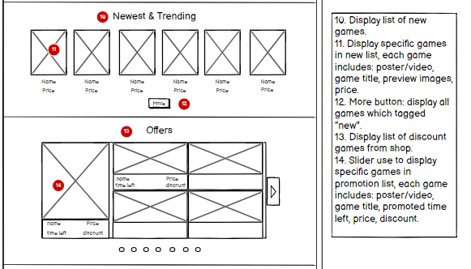
Home Page 2

Slide 25
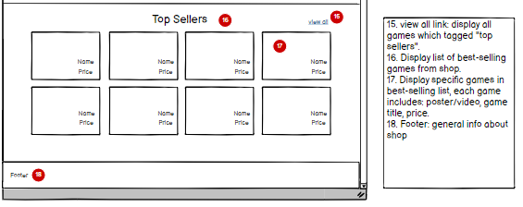
Home Page 3

Slide 26
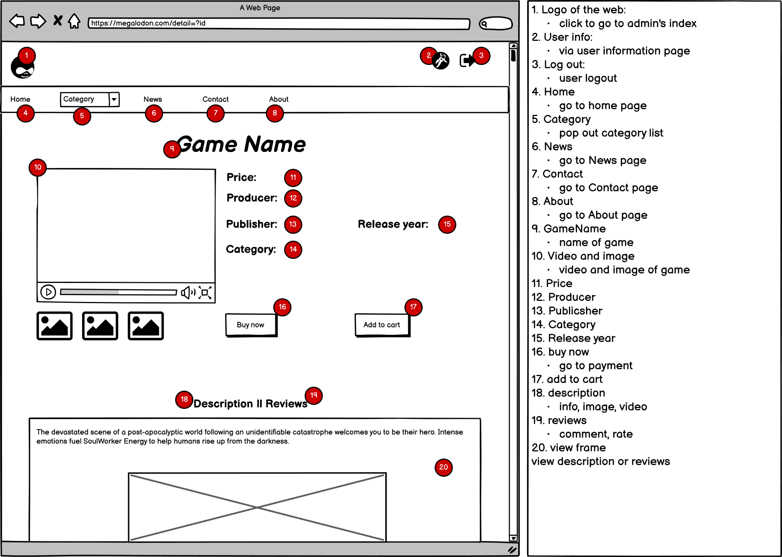

Slide 27
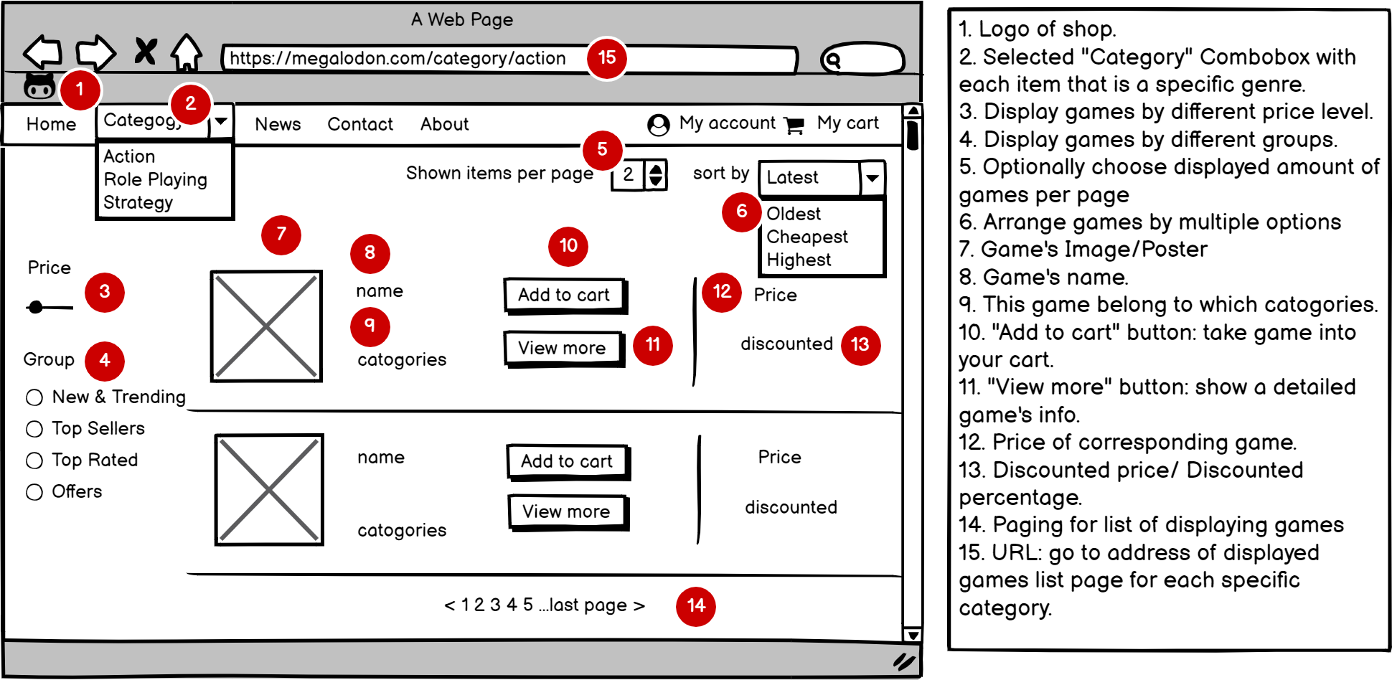

Slide 28
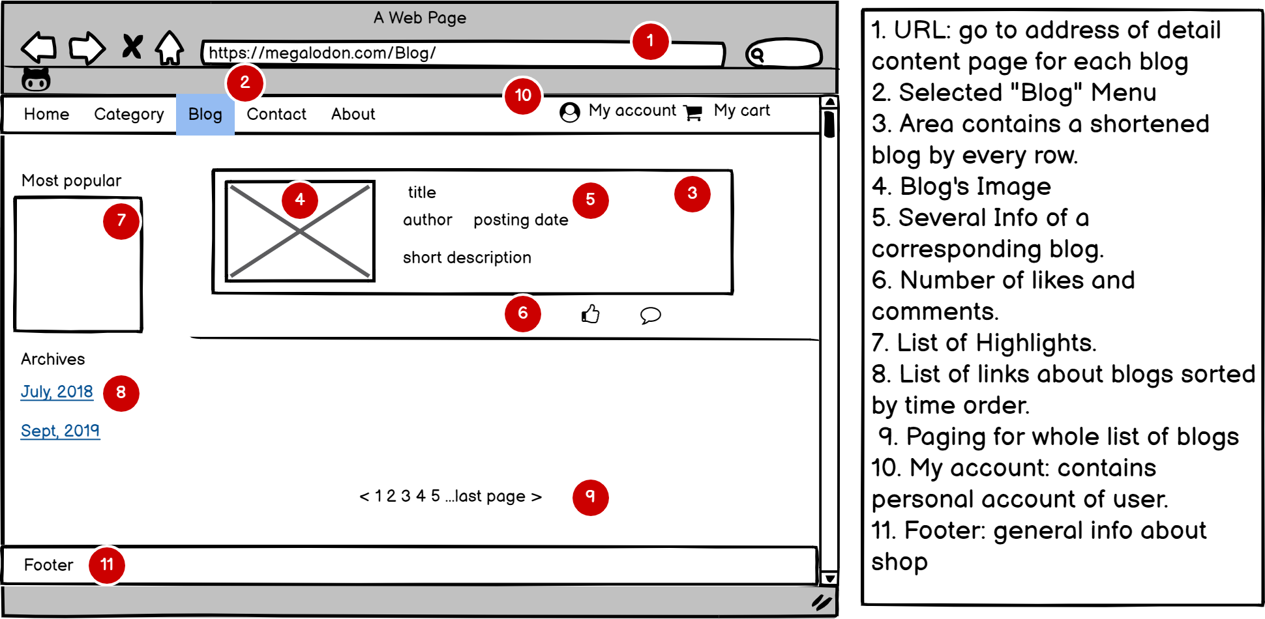

Slide 29
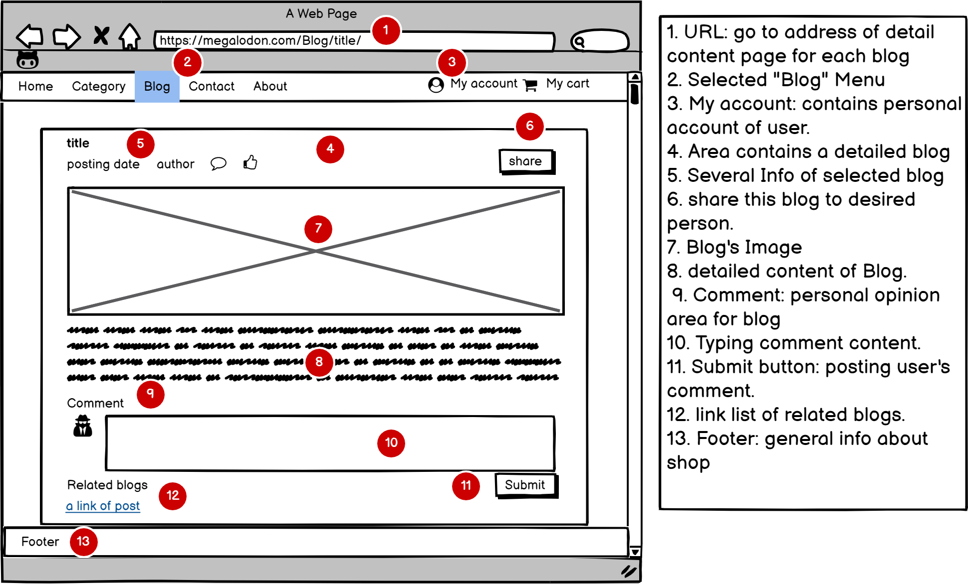

Slide 30
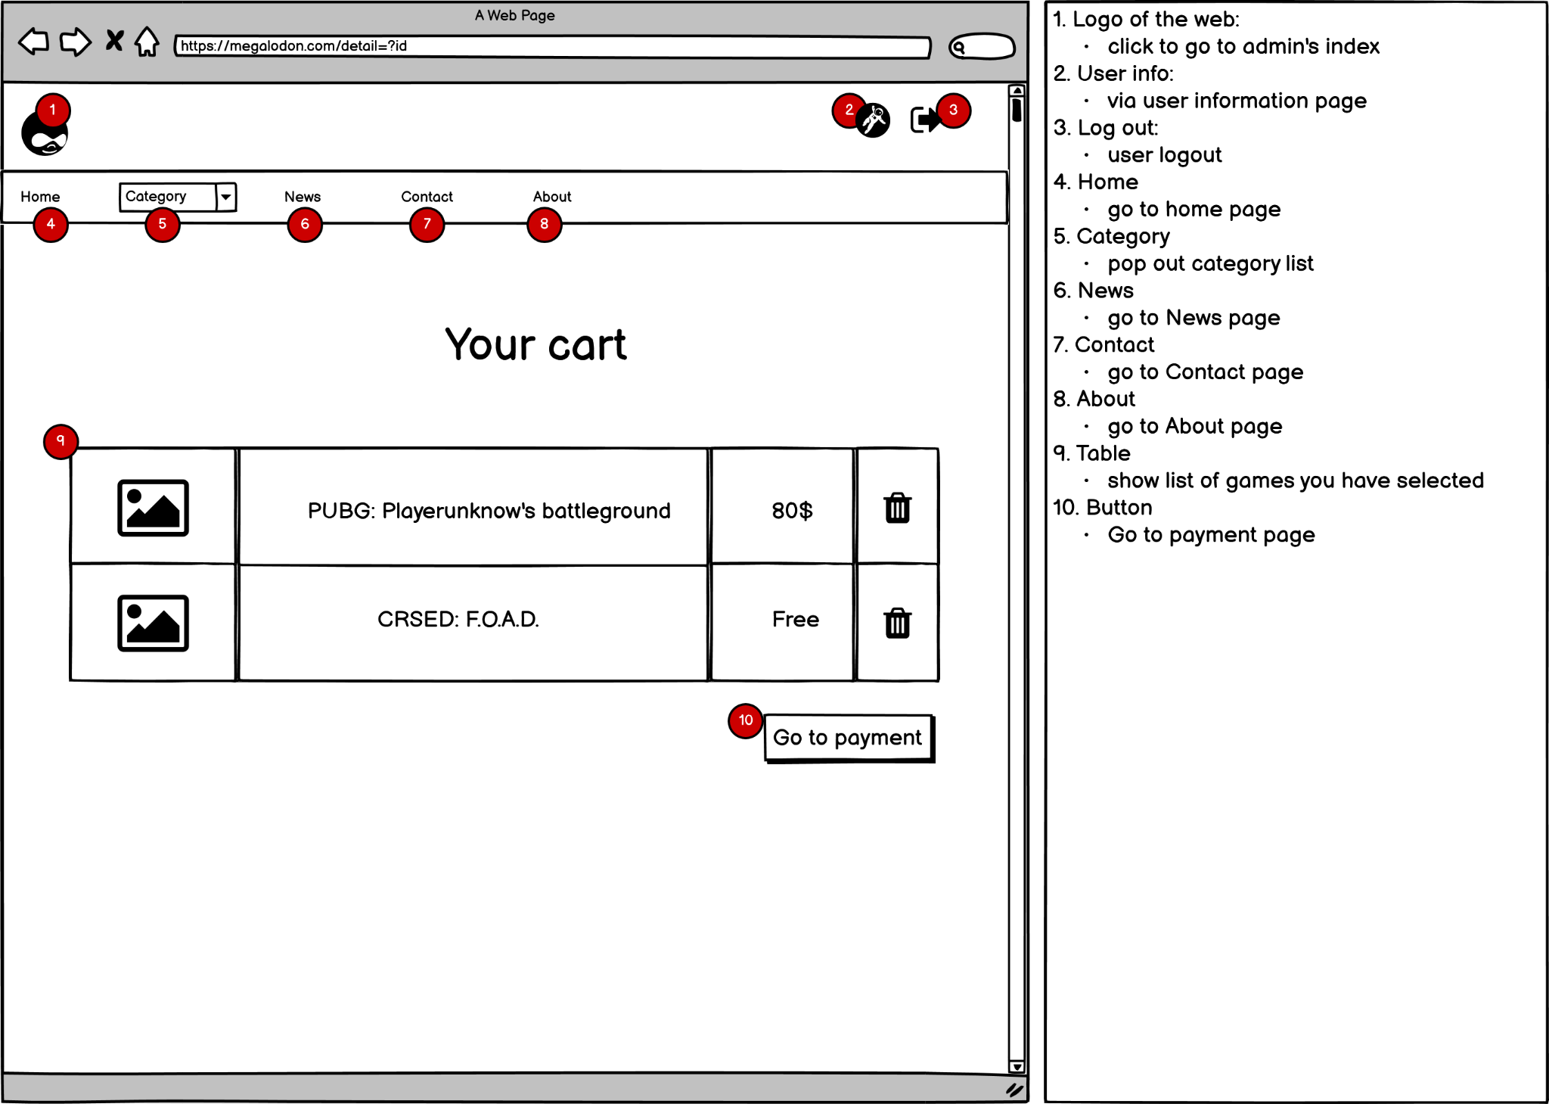

Slide 31
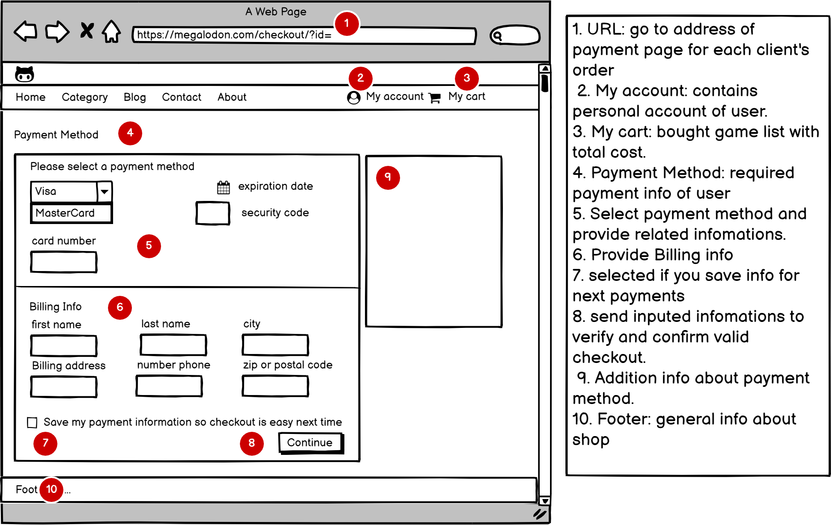

Slide 32
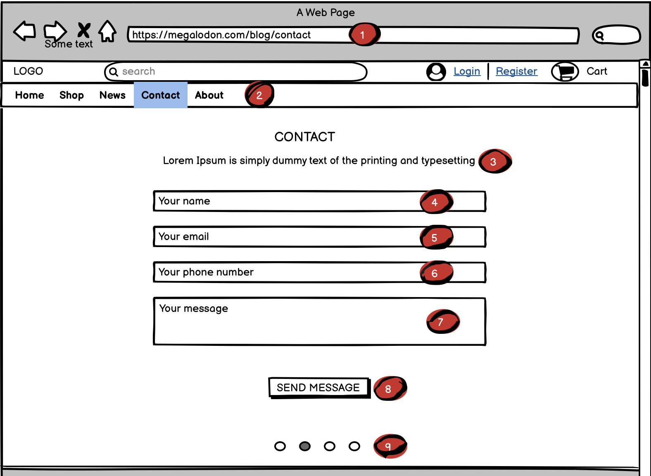
DESCRIPTION (Contact)
1. Firstly, visit the link to the Homepage.
2.Click “Contact” to access this section page.
3. This may contains some details about our contents to section “Contact”
4,5,6,7. You’ll type your information and desire in here to contact us
8. Click this button to transport the above databases to us.
9. The information will shaded with your each mouse’s move.

Slide 33
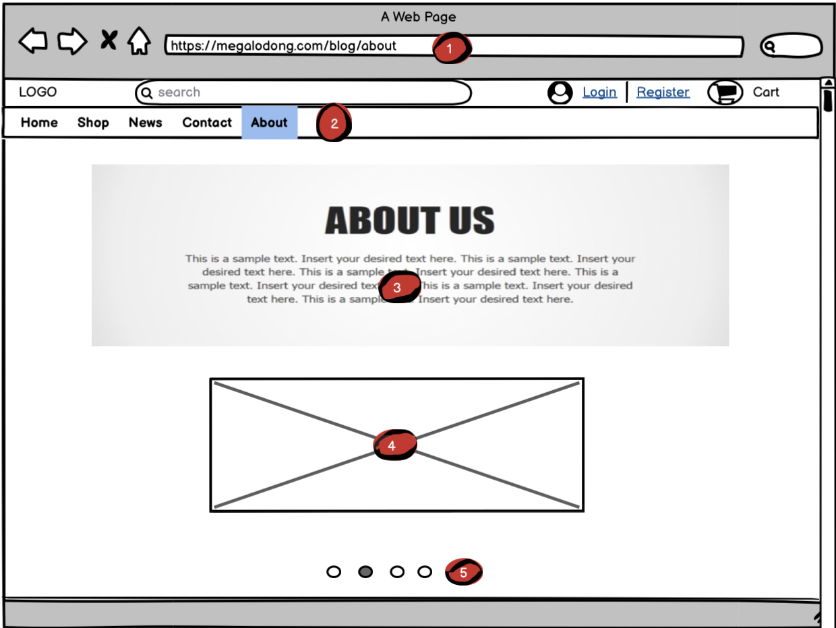
DESCRIPTION (About)
1. Firstly, visit the link to the Homepage.
2.Click “About” to access this section page.
3.The information will shaded with your each mouse’s move.
4. Same as step 3
5. If you want to see another section, move your mouse in here.

Slide 34
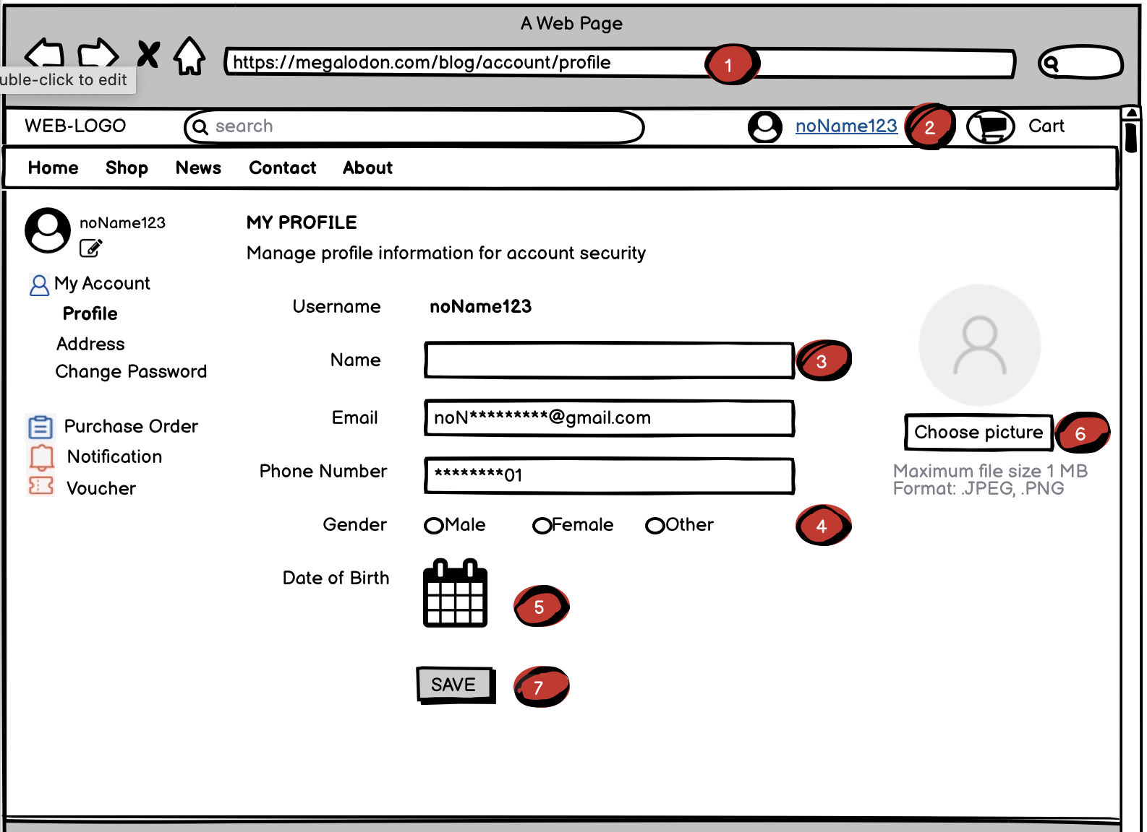
DESCRIPTION (Account)
1. Firstly, visit the link to the Homepage.
2. Log-in successfully.
3,4,5,6. After choose “edit profile” when you move your mouse into <2>, you’ll see these info, it’s up to you to choose edit any things here.
7. Click this button to transport the database to our browser.

